Slide 1
CELEBAL PROJECT
CLOUD-3

Slide 2

Configuration of Azure Data Factory and create pipelines to take data from Azure Blob and insert in into Azure SQL Database

Slide 3
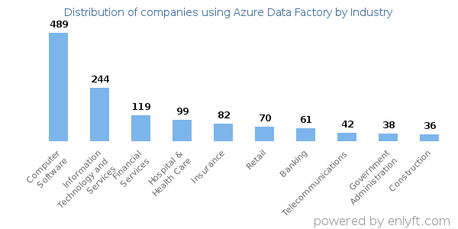
TARGET AUDIENCE
Students seeking career in Cloud Domain.
Industries using Azure Data Factory.

Slide 4
PROJECT GROUP DETAILS
PROJECT MENTOR
Ms. Reema Rani
Assistant Professor
School of Computer Science and Engineering
Poornima University, Jaipur
TEAM MEMBERS
Aarish Ahmed Siddique
Abhishek Singh
Anshita Goyal
Arushi Sukhwal
Teli Udayram

Slide 5
INTRODUCTION
Cloud Computing is the delivery of computing services—including servers, storage, databases, networking, software, analytics, and intelligence—over the Internet. You typically pay only for cloud services you use, helping lower your operating costs, run your infrastructure more efficiently and scale as your business needs change.
Our Project motivation is to “”Create a data factory by using the Azure Data Factory user interface (UI)””.
The pipeline in this data factory copies data from Azure Blob storage to a database in Azure SQL Database.
The configuration pattern in this project applies to copying from a file-based data store to a relational data store.

Slide 6
TECHNOLOGY USED
Azure Data Factory
Azure Blob Storage
Azure SQL Database

Slide 7
OVERVIEW
Azure Data Factory
Azure Data Factory is defined as a cloud-based ETL(extract, transform and load) and data integration service.
The aim of Azure Data Factory is to fetch data from one or more data sources and load them into a format that we process.
It can create data-driven pipelines for orchestrating data movement and transforming data at scale. (orchestration means automating many task together)

Slide 8
OVERVIEW
Azure Blob Storage
Azure Blob storage is a feature of Microsoft Azure which allows users to store large amounts of unstructured data.
Blob stands for Binary Large Object, which includes objects such as images and multimedia files. These are known as unstructured data because they don’t follow any particular data model.

Slide 9
OVERVIEW
Azure SQL Database
Azure SQL Database is a cloud-computing database service, that is offered by Microsoft Azure Platform which helps to host and use a relational SQL database in the cloud without requiring any hardware or software installation. Also, it provides various advanced features like:
Long-term backup retention
Geo-replication
Automatic tuning
High-availability
Automated backups

Slide 10
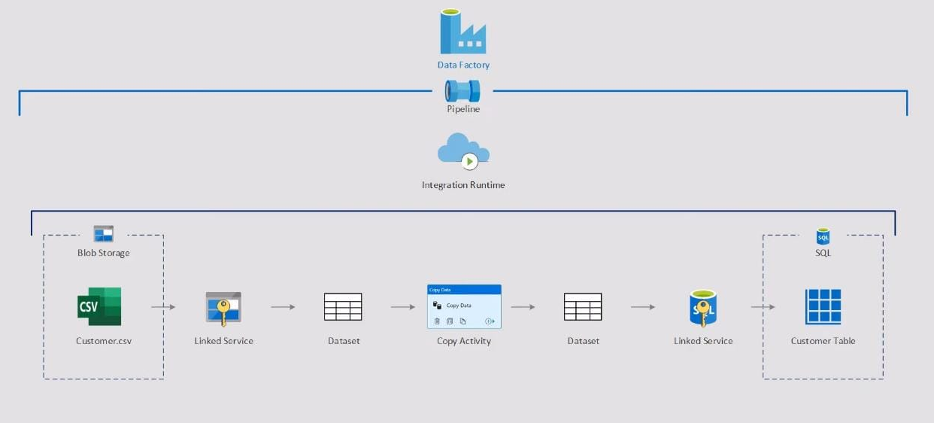
WORKING

Slide 11
WORKING..
Upload a .csv file in Blob Storage and create a table in Azure SQL Database.
Create two linked service and datasets for Azure Blob Service and Azure SQL database in Data Factory pipeline.
Azure pipeline will fetch data from source(Azure Blob Storage) and will copy it to sink(Azure SQL Database).
Hence, data from Azure Blob Storage is copied to SQL database by configuring pipeline in Azure Data Factory.

Slide 12
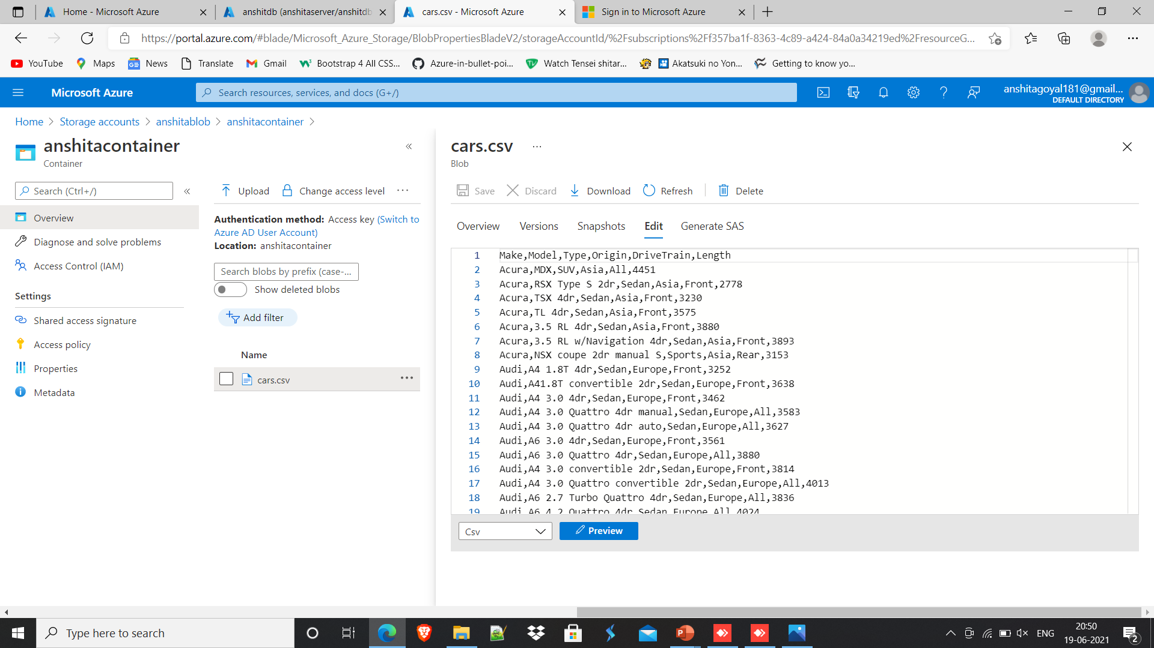
Step 1: Upload a .csv file in Blob Storage.

Slide 13
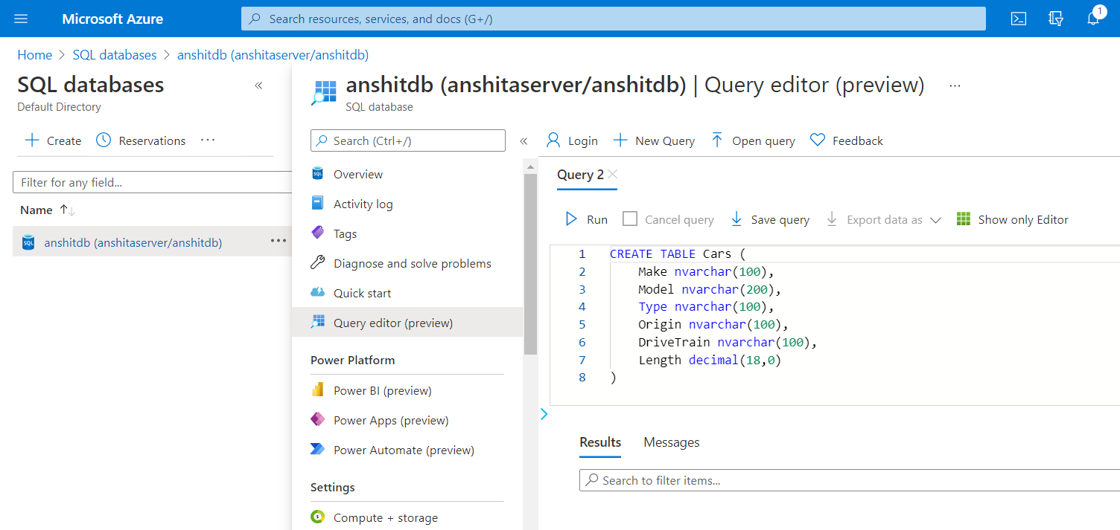
Step 2: Create a table in Azure SQL Database.

Slide 14
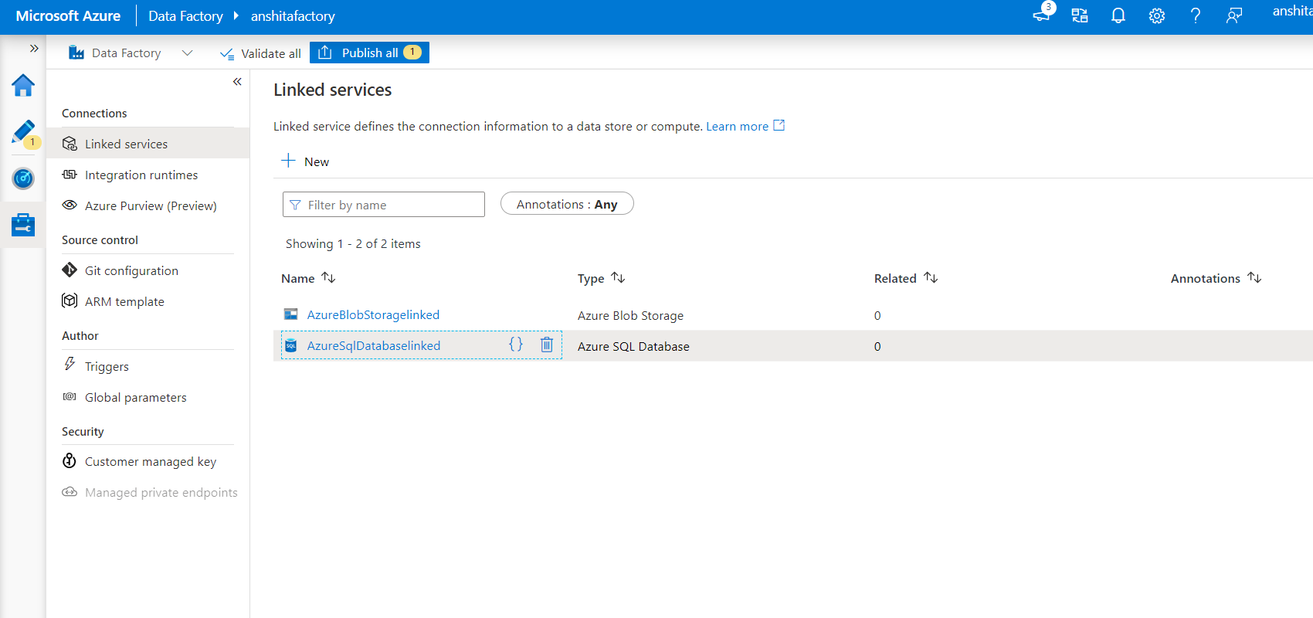
Step 3: Create two linked service for Azure Blob Service and Azure SQL database in Data Factory pipeline.

Slide 15
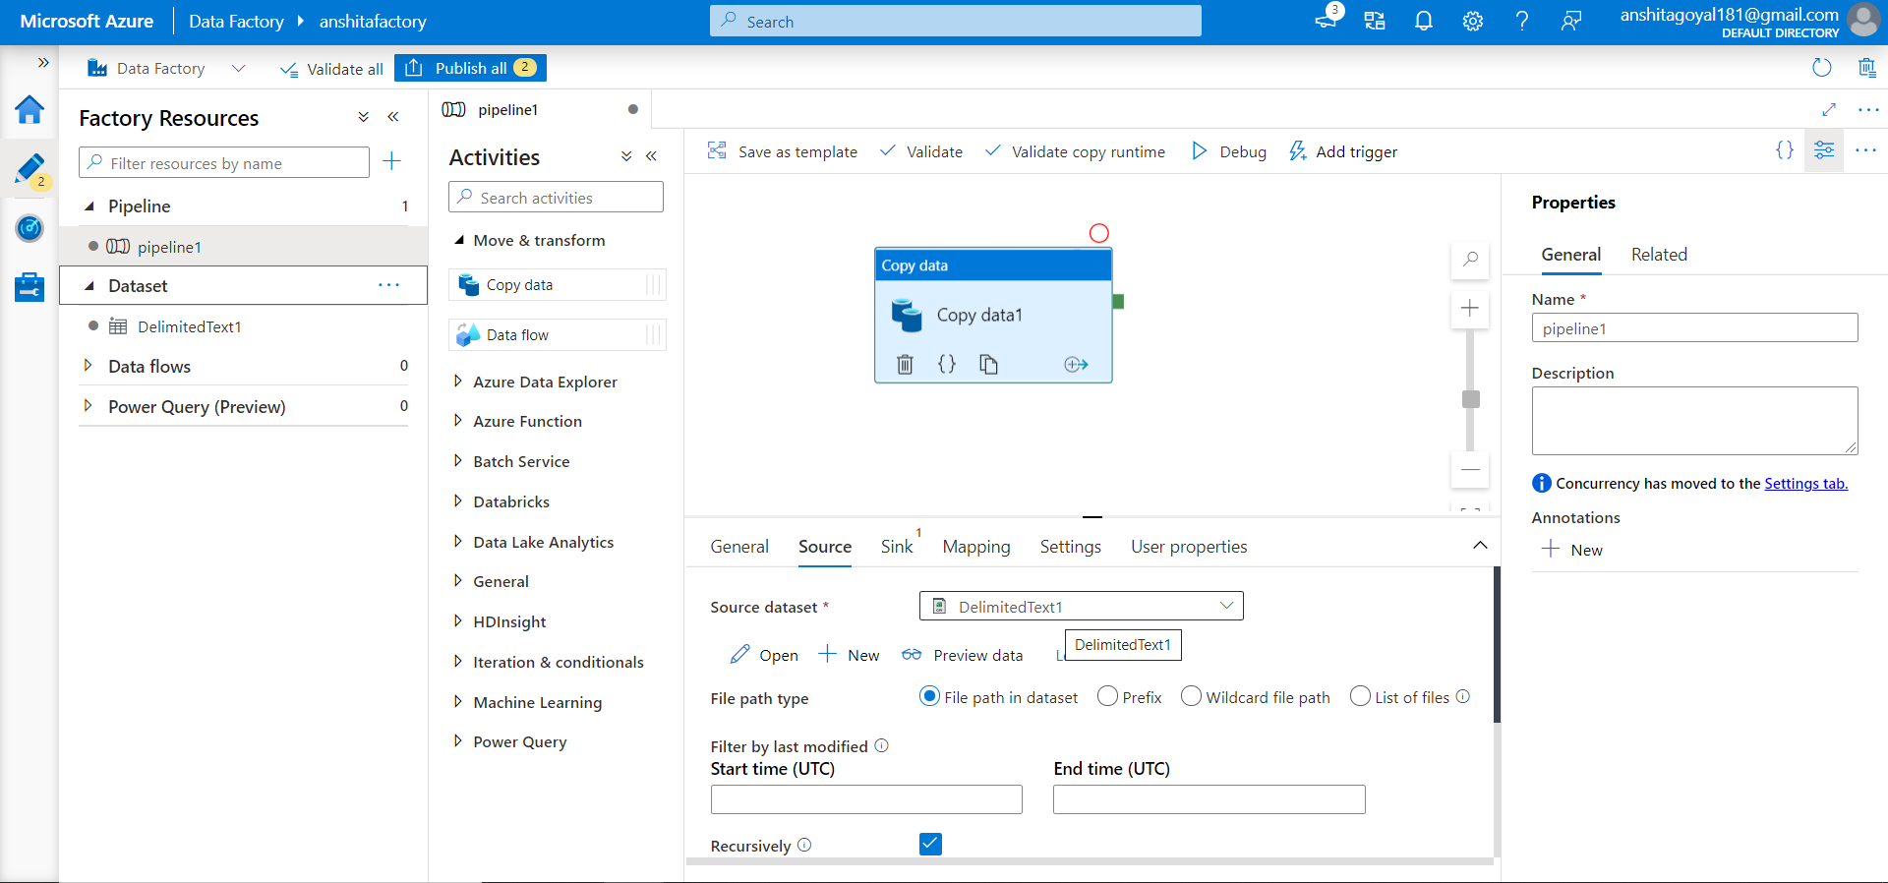
Step 4: Provide the path to .csv file in blob storage in the source section dataset.

Slide 16
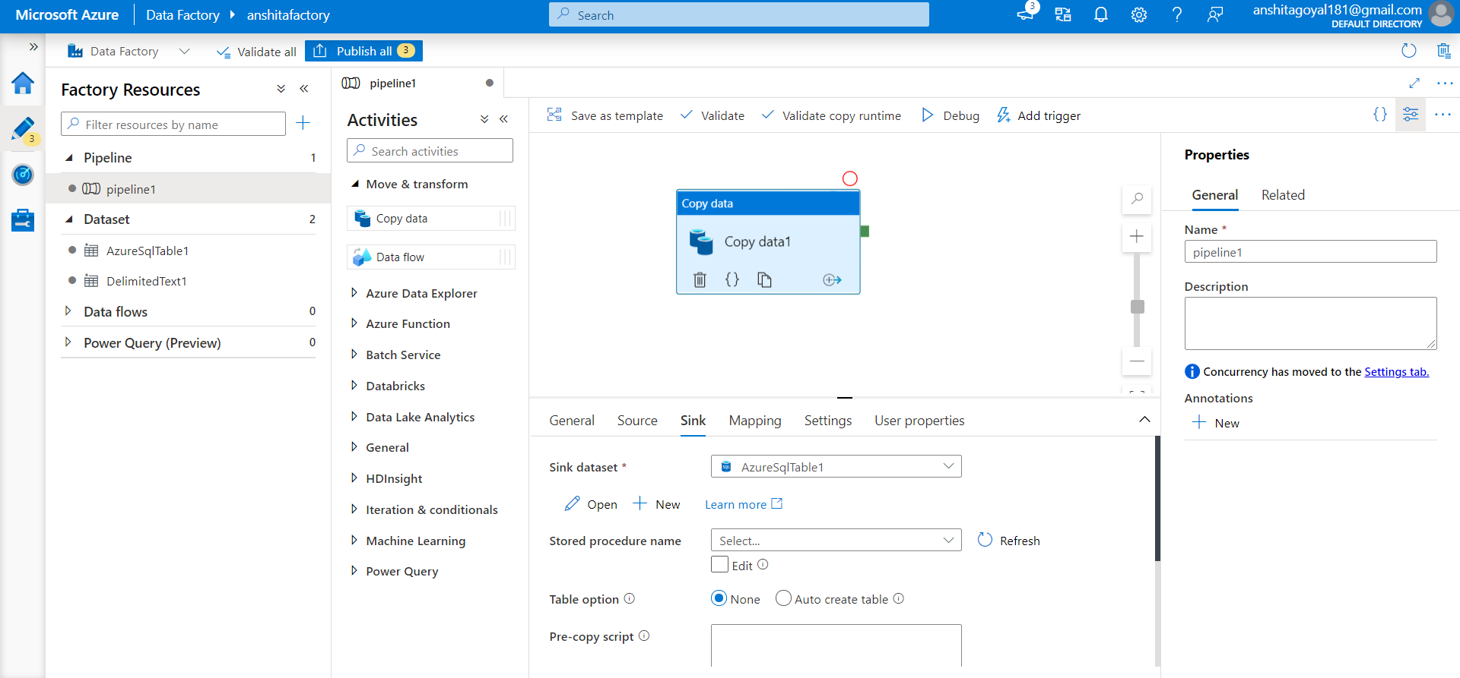
Step 5: Give database name in sink section dataset.

Slide 17
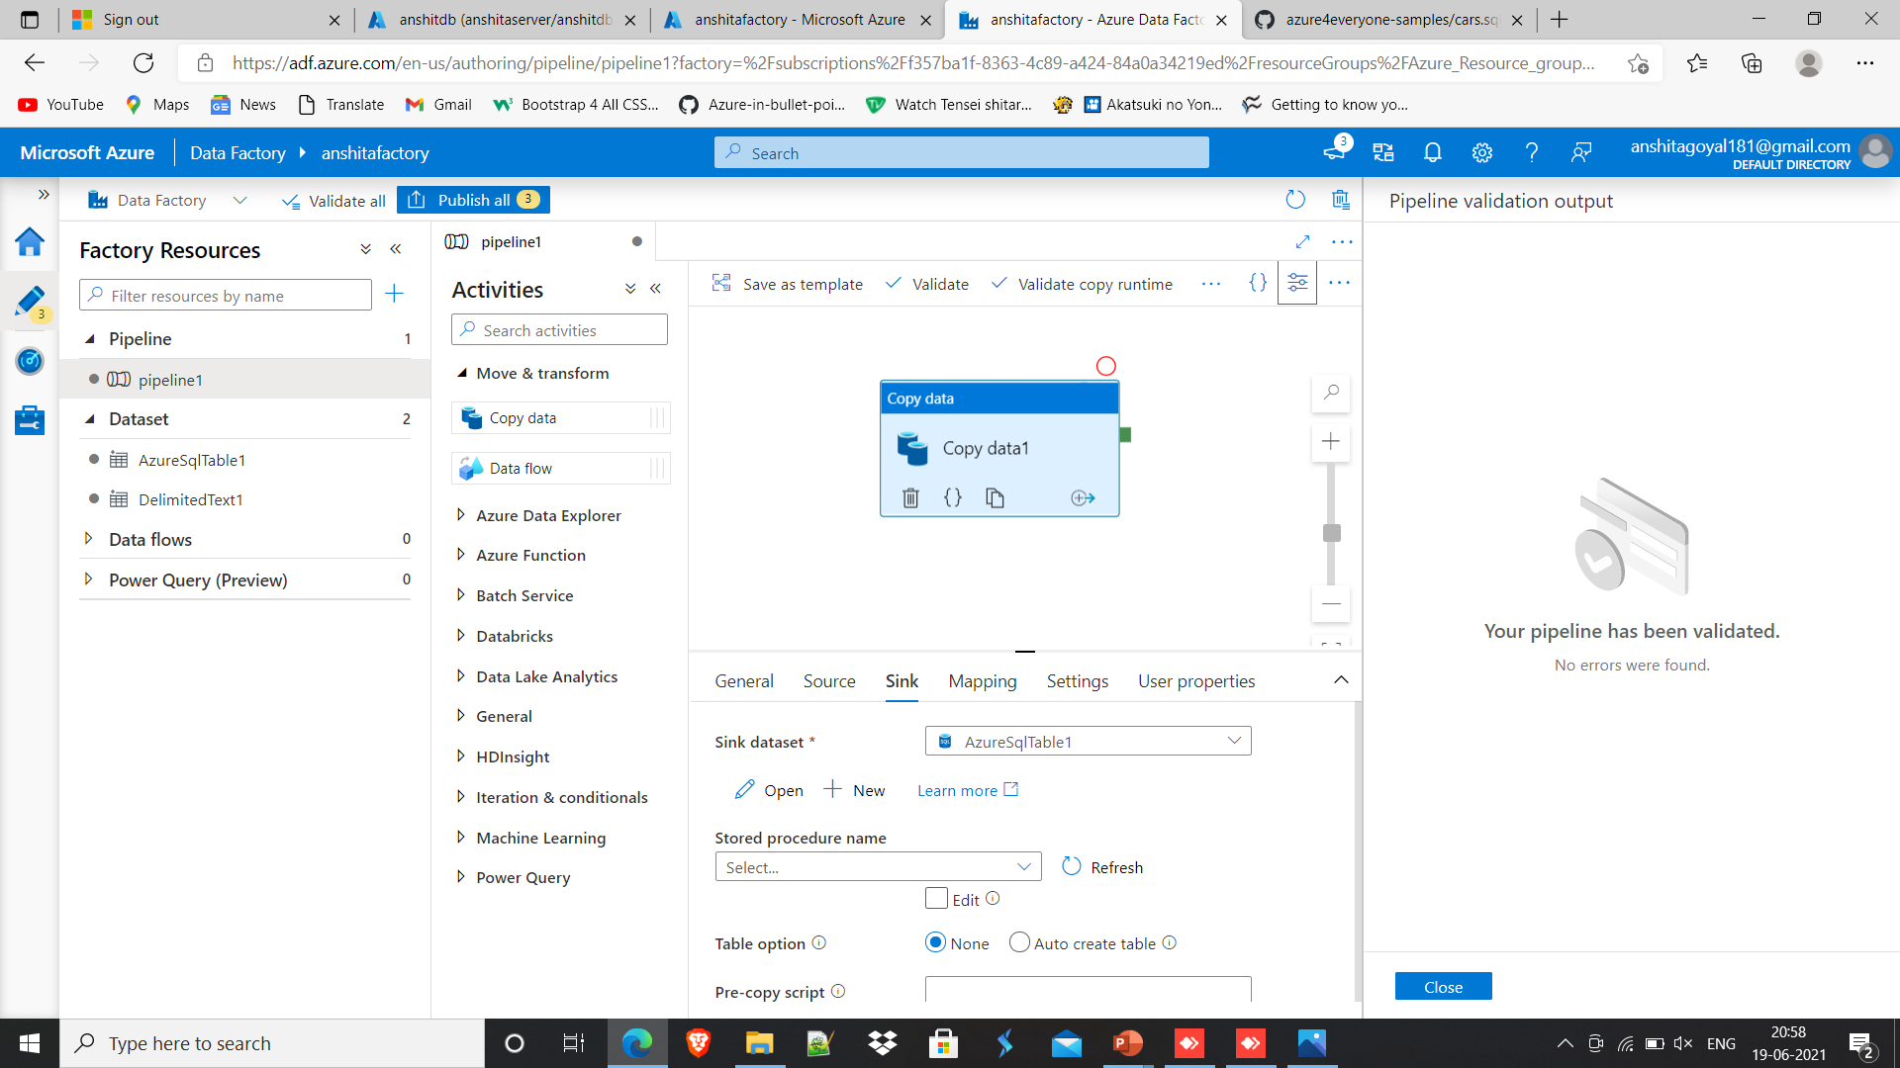
Step 6: Run ”Validate” to check whether there are errors.

Slide 18
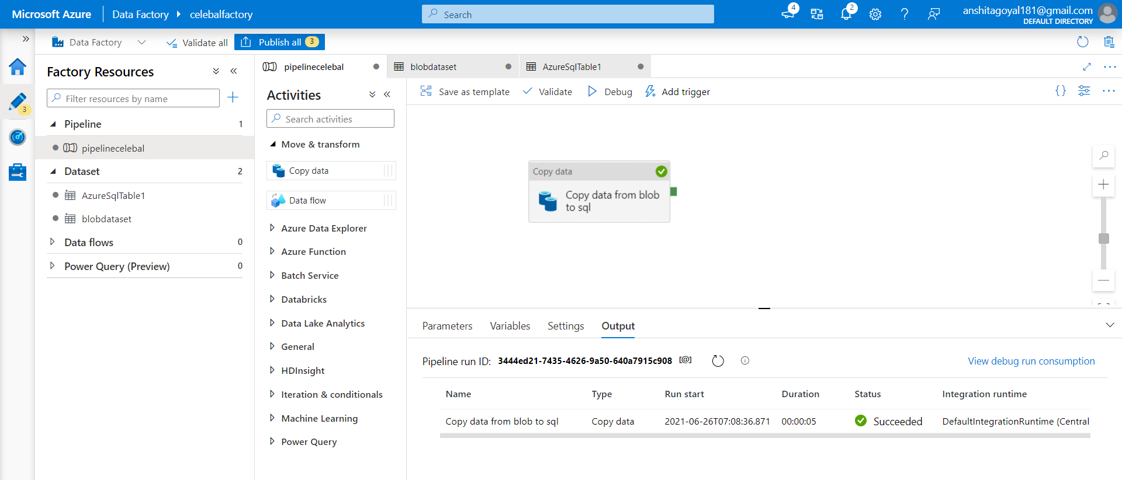
Step 7: Run ”Debug” to automate the process.

Slide 19
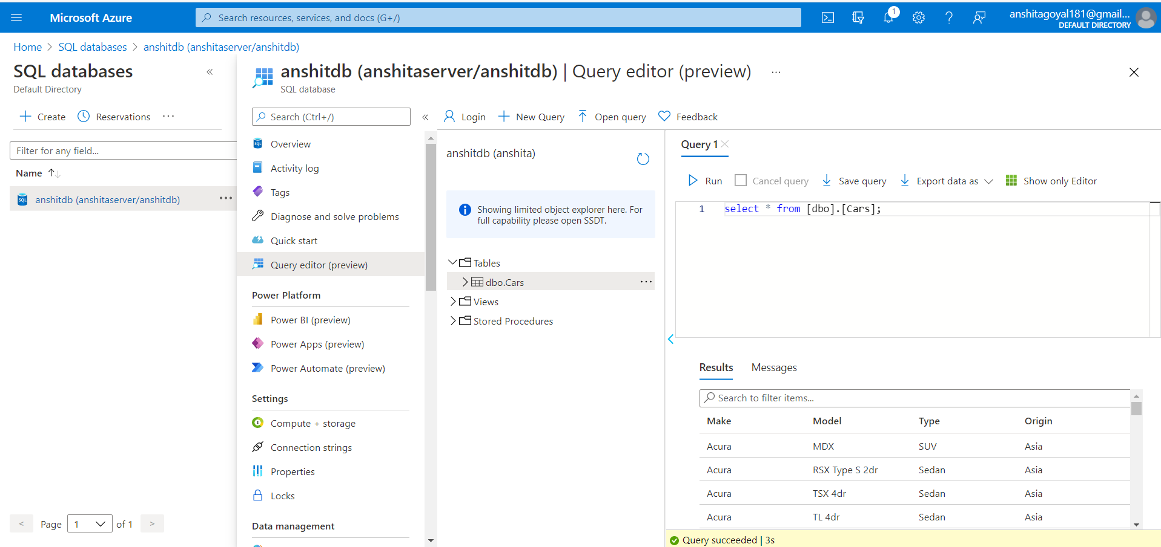
Step 8: In SQL database, run “select” query in query editor to confirm that data has been copied.

Slide 20
FUTURE SCOPE
According to sources, 2.5 quintillion bytes of data is generated everyday. Research from IDC shows that 80% of worldwide data produced will be unstructured, means it is typically text heavy and does not follow a predefined data model.
According to our project we have used blob storage as a source for our unstructured data. Moreover, if we expand the scope of this project we can also take the data directly as generated from –
Azure services – Data Lake, Iot Hub.
FTP servers
3rd Party applications such as google drive, github, and many more.
E-commerce websites
Audio, video and images content

Slide 21

Configured Azure Data Factory and created pipelines to take data from Azure Blob and inserted in into Azure SQL.

Slide 22
THANK YOU

